Slide 1
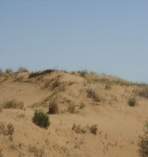
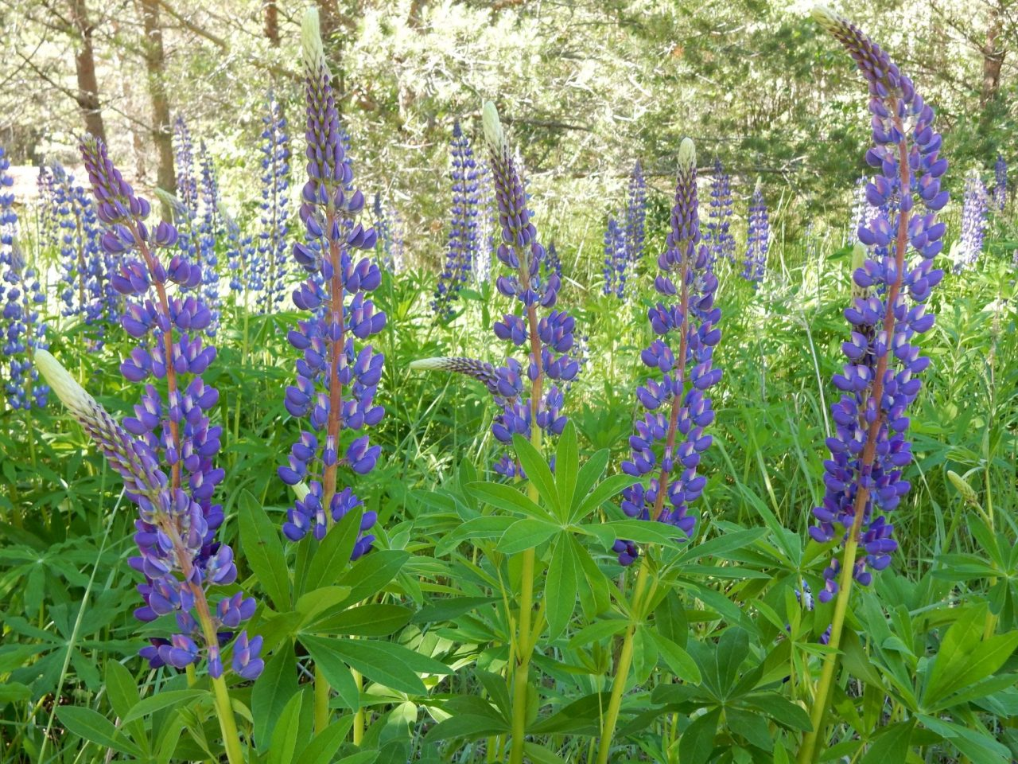
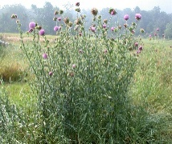


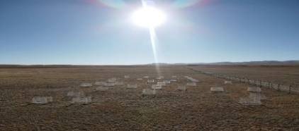
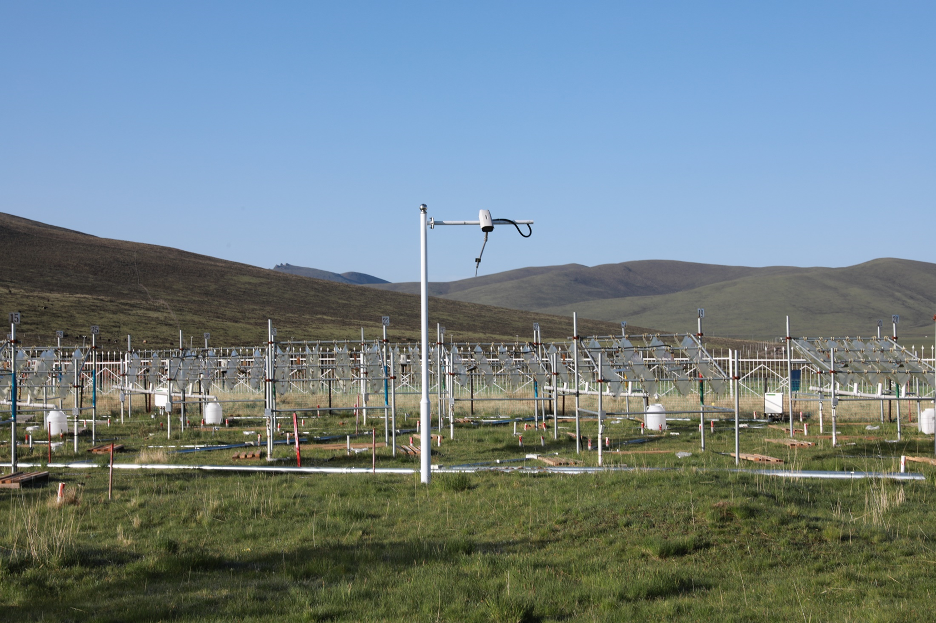

Global change
Biodiversity
conservation
Invasion
control
Outbreak
management
4700 a.s.l.
3200 a.s.l.
Photo from
Ningning Zhao
Photo from
Jin-Sheng He
Photo from
Xueyan Wang
Photo from
Satu Ramula
Photo from
Katriona Shea
Photo from
Google
Photo from
Baidu
Photo from
Joseph Keller
Population management
Models & empirical data

Slide 2
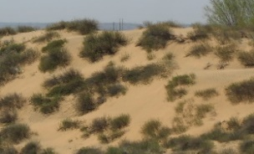
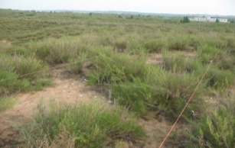
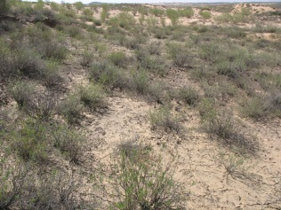
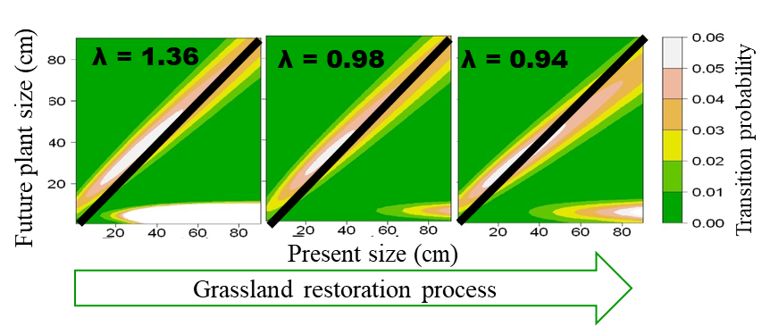
Semi-Fixed
Fixed
fixed
Fixed-Crust
Main findings: Both individual and population performance declines as the dune stabilizes
Slight disturbance helps to keep the populations growing.

Slide 3
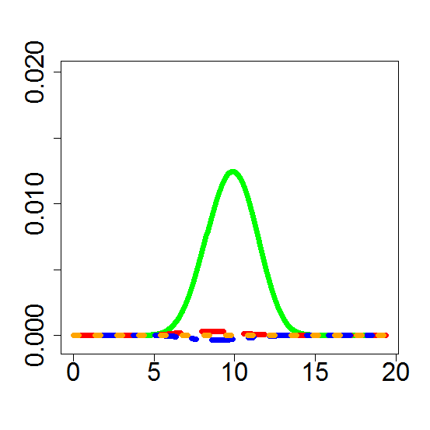
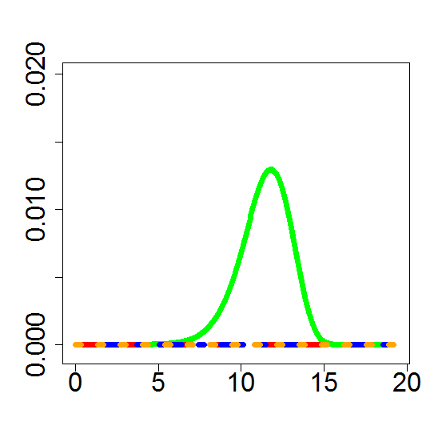
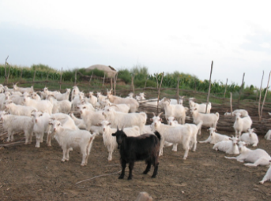
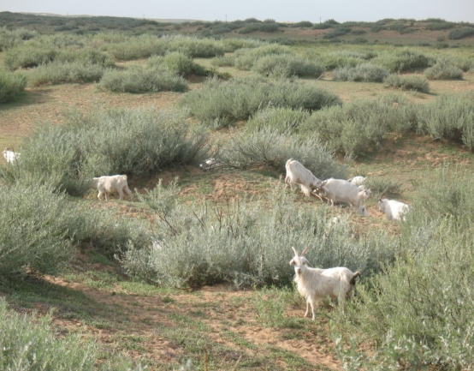
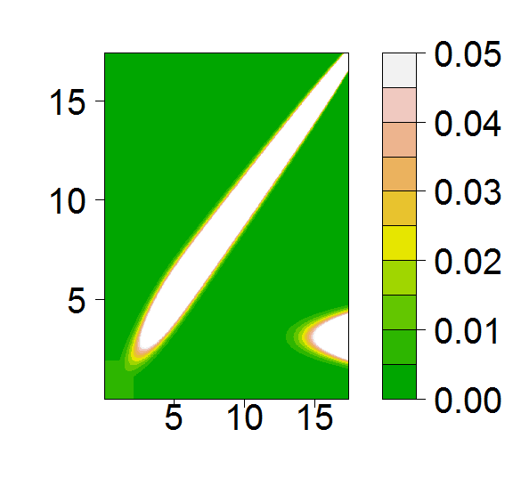
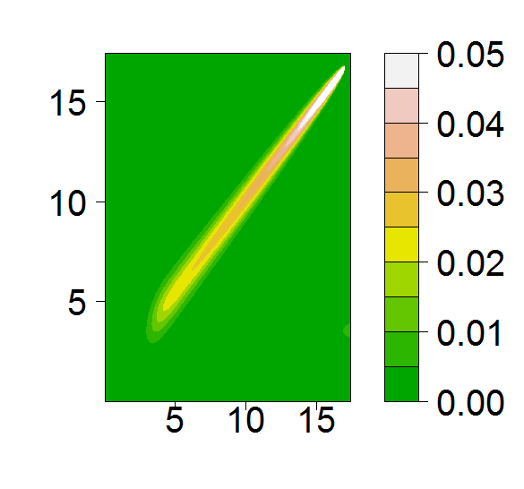
Grazing cessation
Seasonal Grazing
λ= 0.992 [0.982, 1.082]
λ= 1.000 [0.999, 1.001]
Log (future plant size cm³)
Log (present plant size cm³ )
Main findings: seasonal grazing greatly reduced fecundity, but had
little effect on population growth rate (λ)

Slide 4
Grazing cessation
Seasonal Grazing
λ= 0.992 [0.982, 1.082]
λ= 1.000 [0.999, 1.001]
Log (future
plant size cm³)
Relative
sensitivity
0.00 0.01 0.02
0 5 10 15 20
0 5 10 15 20
Log (present plant size cm³ )
Main findings: seasonal grazing greatly reduced fecundity, but had little effect on population growth rate (λ)

Slide 5
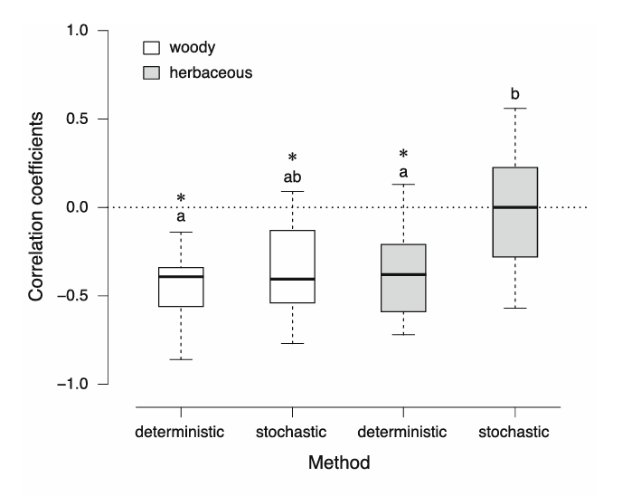
Main findings: conclusions on demographic strategies were jointly affected by life form and modelling method.

Slide 6
Main findings: conclusions on demographic strategies were jointly affected by life form and modelling method.
Note: Shown are Spearman’s rank correlation coefficients between the variability of vital rates and their importance for population growth rate. Different letters indicate significant differences between methods, asterisks indicate correlation coefficients are significantly different from zero, and a negative coefficient value indicates a buffering strategy against environmental variation

Slide 7
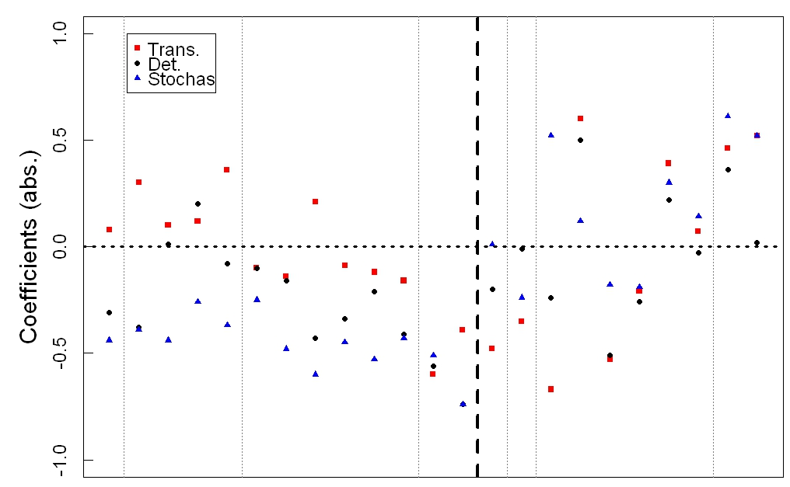
Woody plant species
Herbaceous plant species

Slide 8
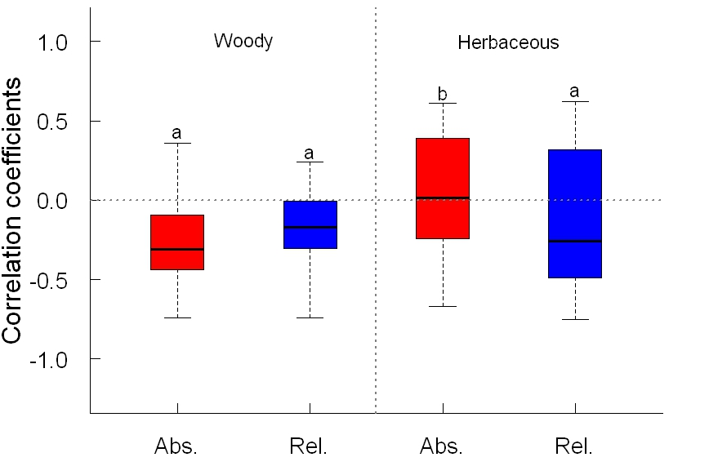

Slide 9
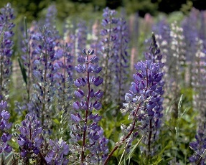
Lupinus polyphyllus
37 Lupinus polyphyllus
populations in Finland
Notes:
Here, we combine genetic analyses and demographic study over the whole life-cycle to investigate to assess the role of genetic variation in invasion success.
Lupinus polyphyllus is a perennial herbaceous plant, it originates from North America and is invasive in Europe, southern Australia and New Zealand. The species was introduced into southern Finland as a garden plant in the late 1800s, and it escapes the garden started to inhabits infertile or disturbed environments, such as road verges, wastelands and forest understories. It is currently spreading northwards, imposing a threat to native flora
Our genetic analysis was based on SSR, which is simple sequence repeat, and 13 markers were selected and used for this study, with 37 natural populations. Demographic data in the same 37 populations were collected and integral projection models were built to calculate the long term population growth rate.

Slide 10
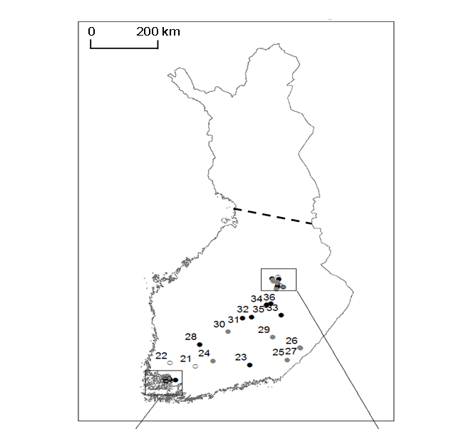
Lupinus polyphyllus
37 L. polyphyllus populations in Finland
 | Population diversity (H′)
Response variable | F (_{df; ddf}) | P
Seedling establishment | 318.000 _{1;35} | 0.046
Growth | 0.258 _{1;33} | 0.615
Survival | 0.429 _{1;33} | 0.517
Seed production | 60.756 _{1;34} | 0.484
Population growth rate (λ) | 0.354 _{1;34} | 0.227
Main findings: Populations were able to spread equally well regardless of genetic diversity
Only looking at early life stages may be misleading
Notes:
However, vital rates of later life stages were not affected by genetic diversity. That could be because that the deleterious recessive alleles were already purged out at the seedling stage, Purging may release populations of their genetic load, leaving only the fittest individuals with high invasion potential .

Slide 11
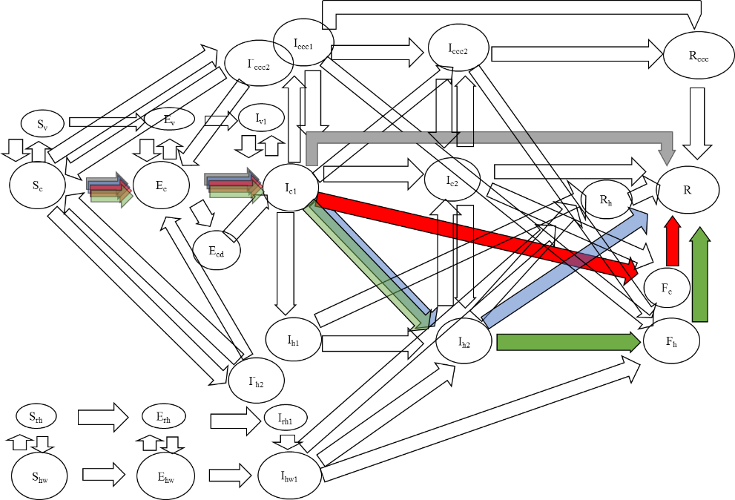

Slide 12

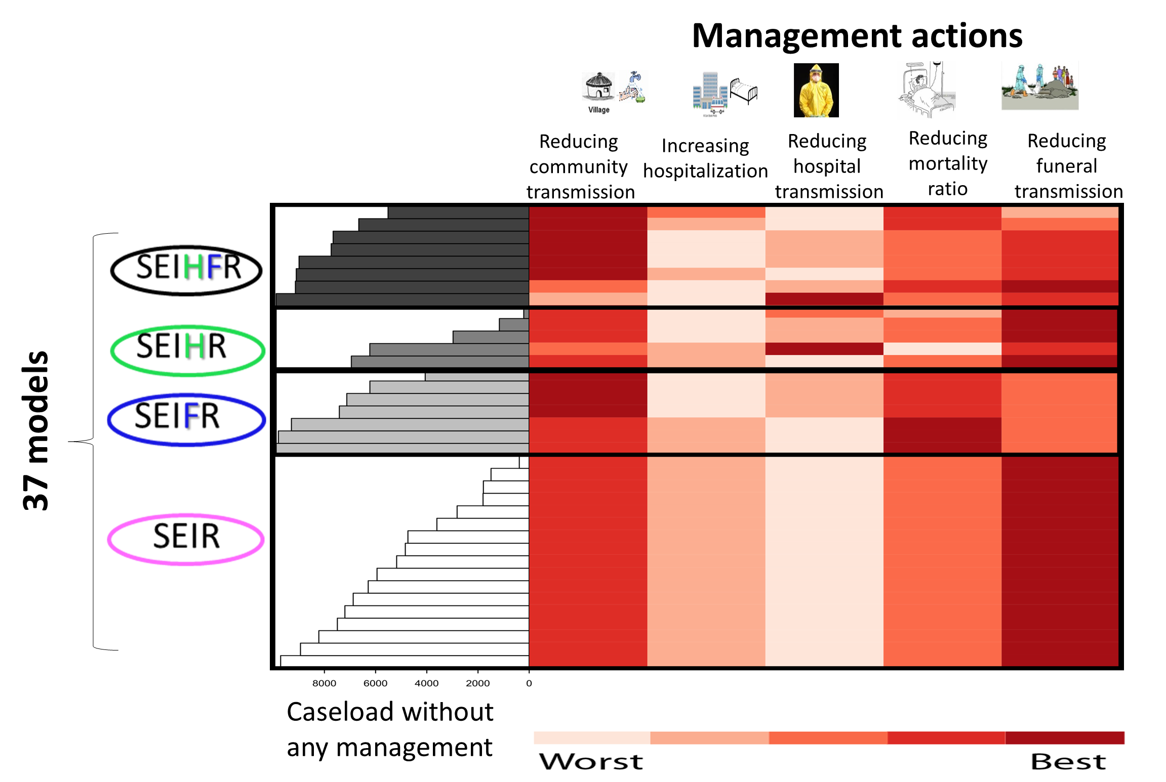
“Global” model

Slide 13
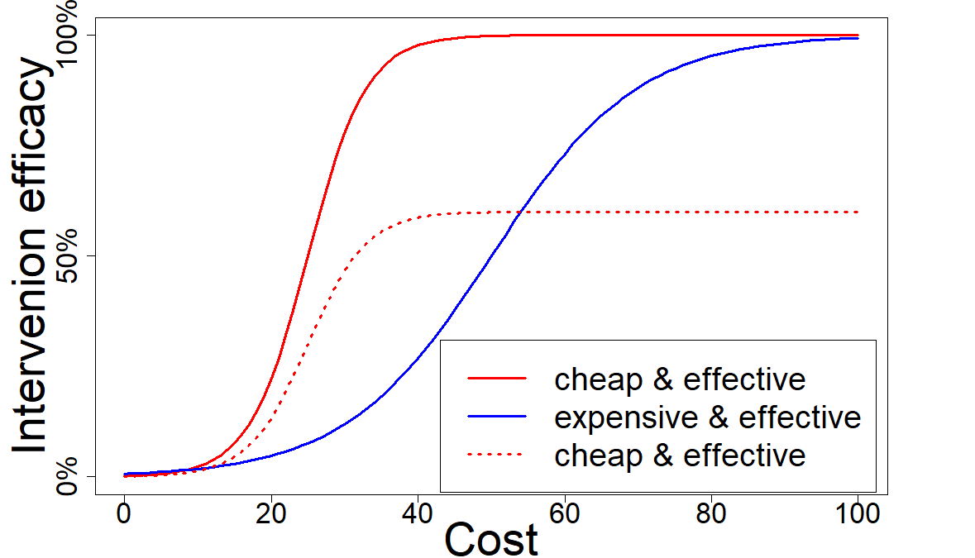
S
E
I
R
Changes in model parameters
H
F
37 compartment models
affect
Effectiveness of
interventions
Management outcome
Bilogical uncertainty
affects
Operational uncertainty
Candidate Interventions

Slide 14
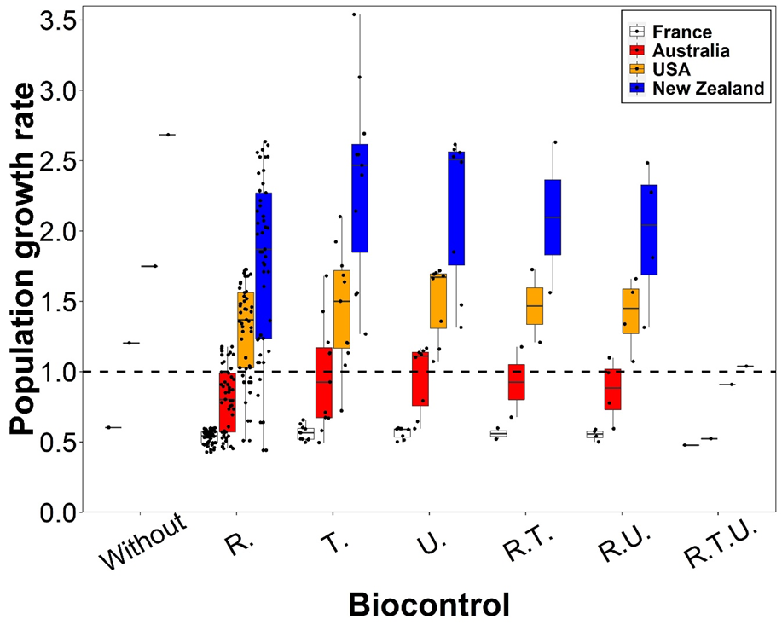
Population growth rate under different effectiveness levels of biocontrol agents in empirical studies. The biocontrol agents are Trichosirocalus horridus (T.), Rhinocyllus conicus (R.) and Urophora solstitialis (U.).

Slide 15
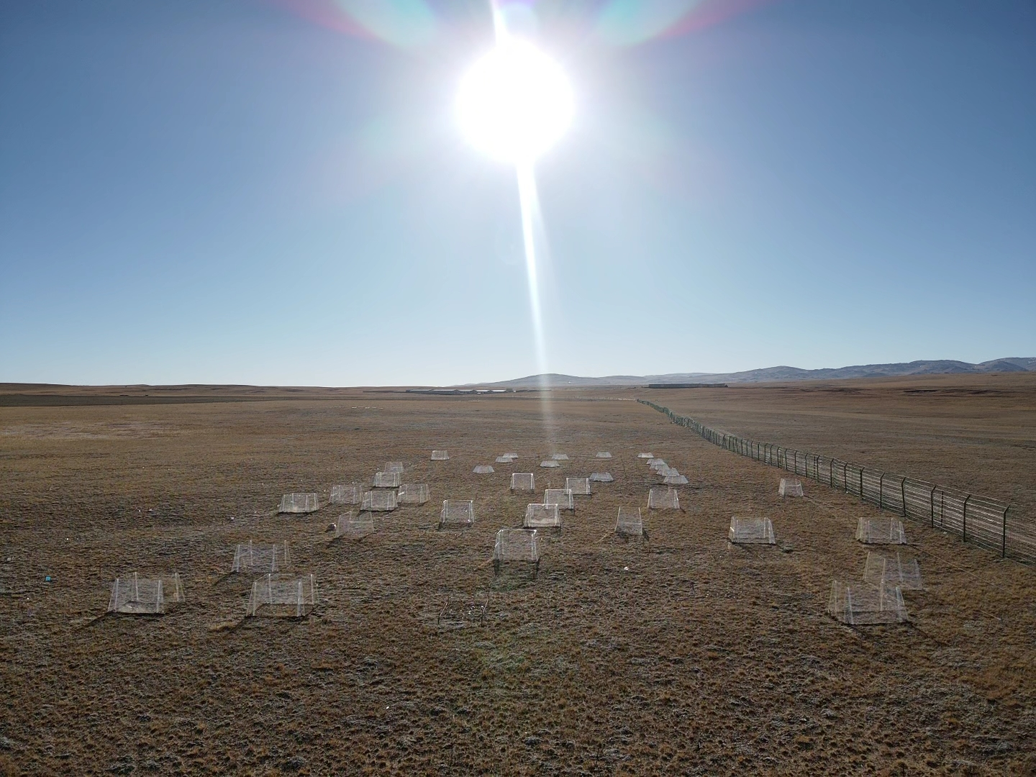

Slide 16
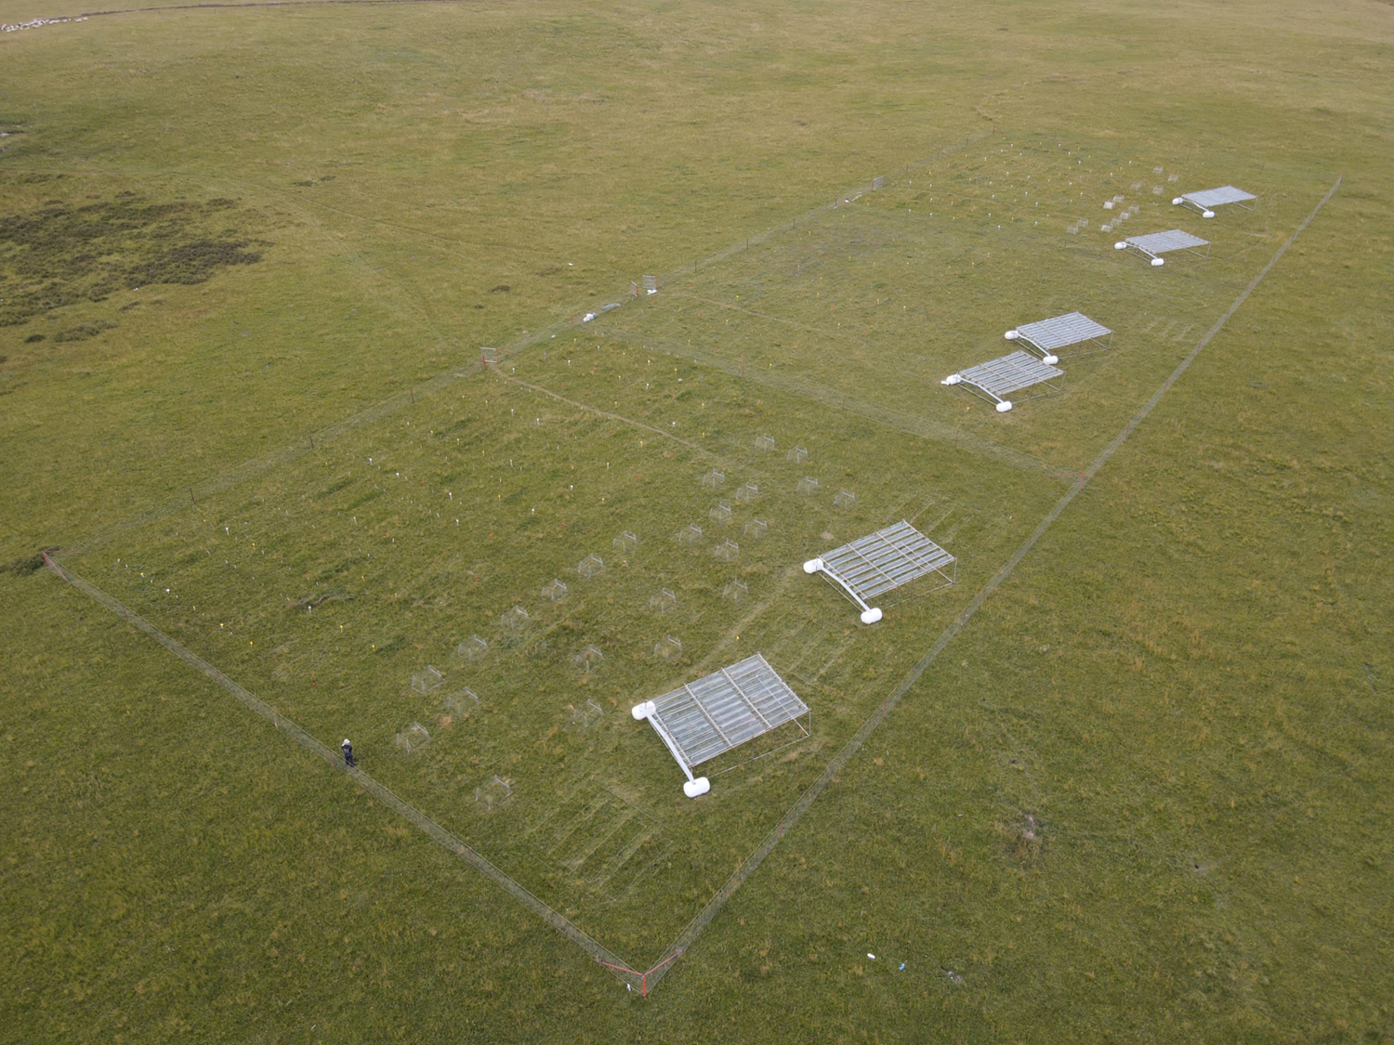

Slide 17
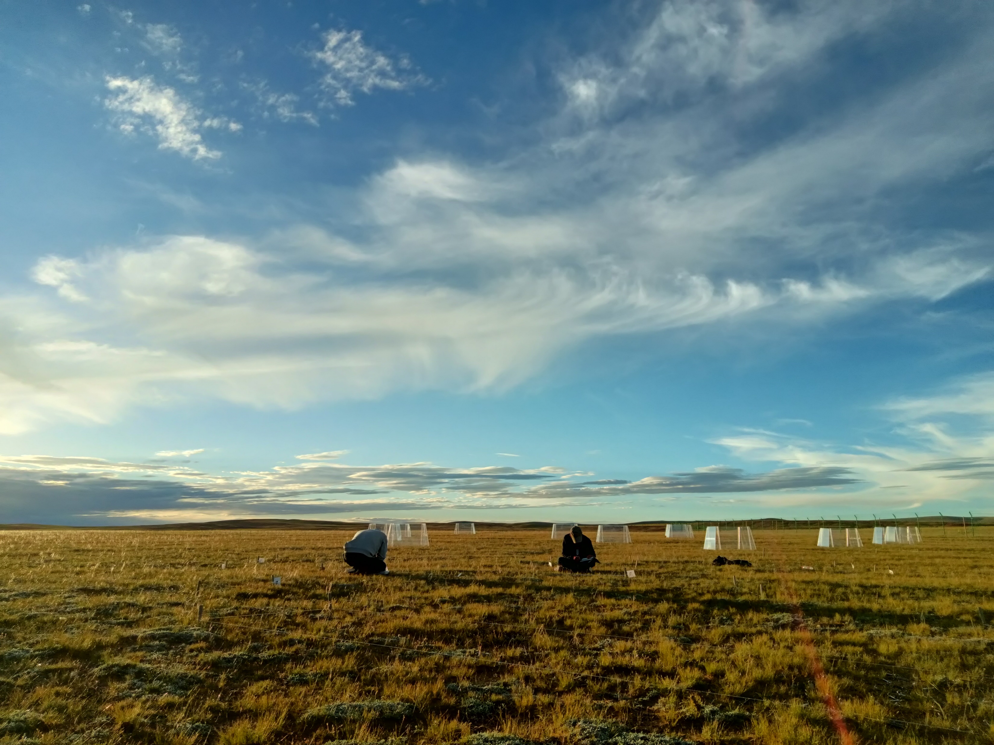
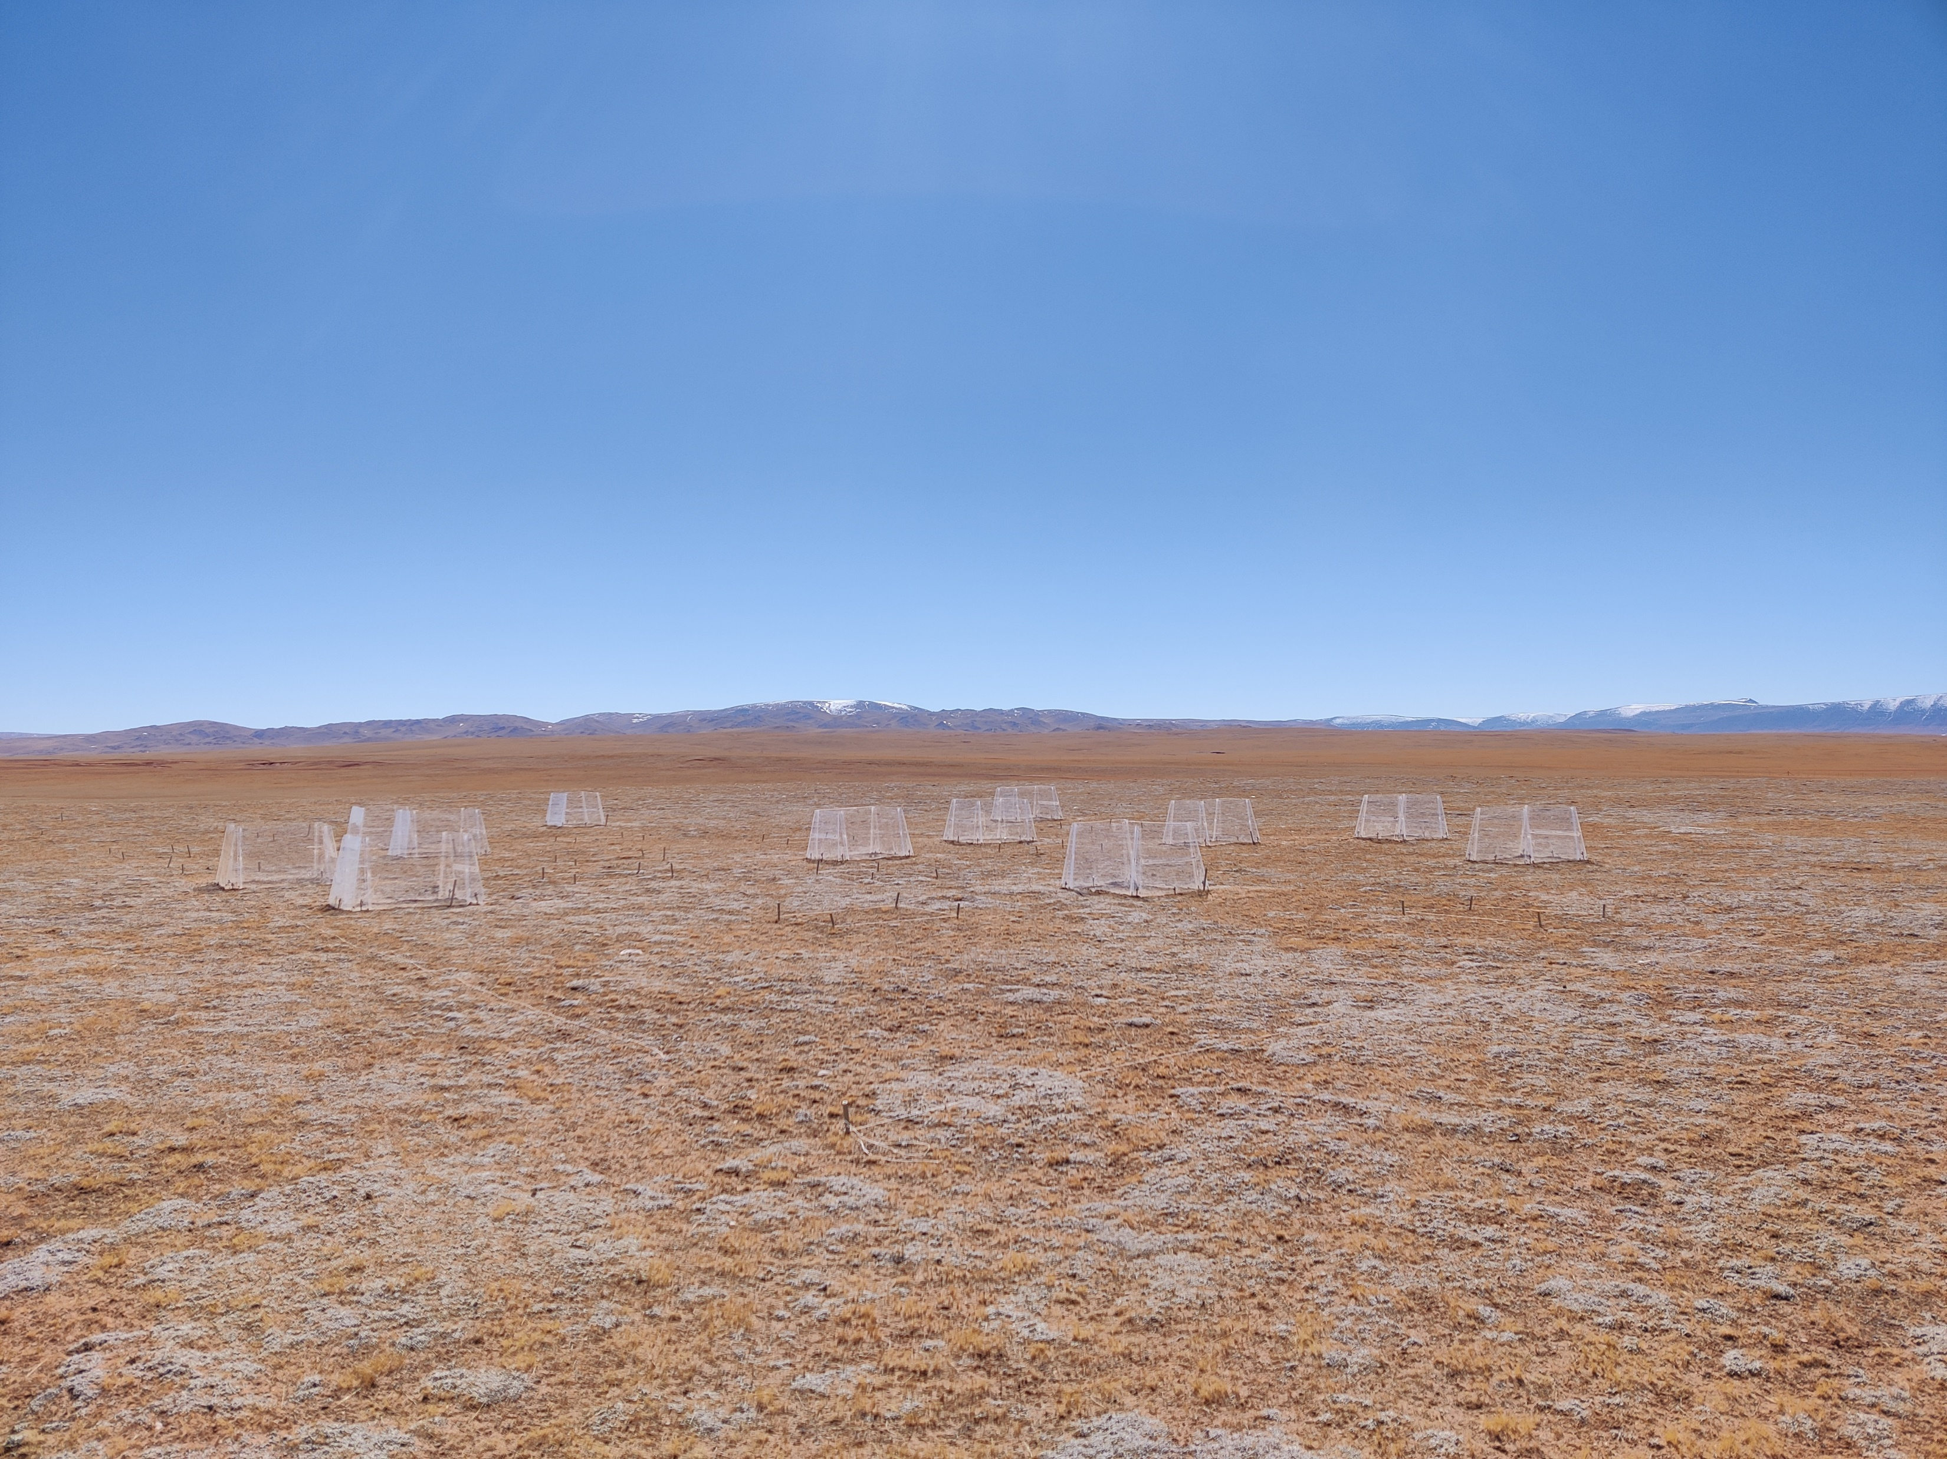
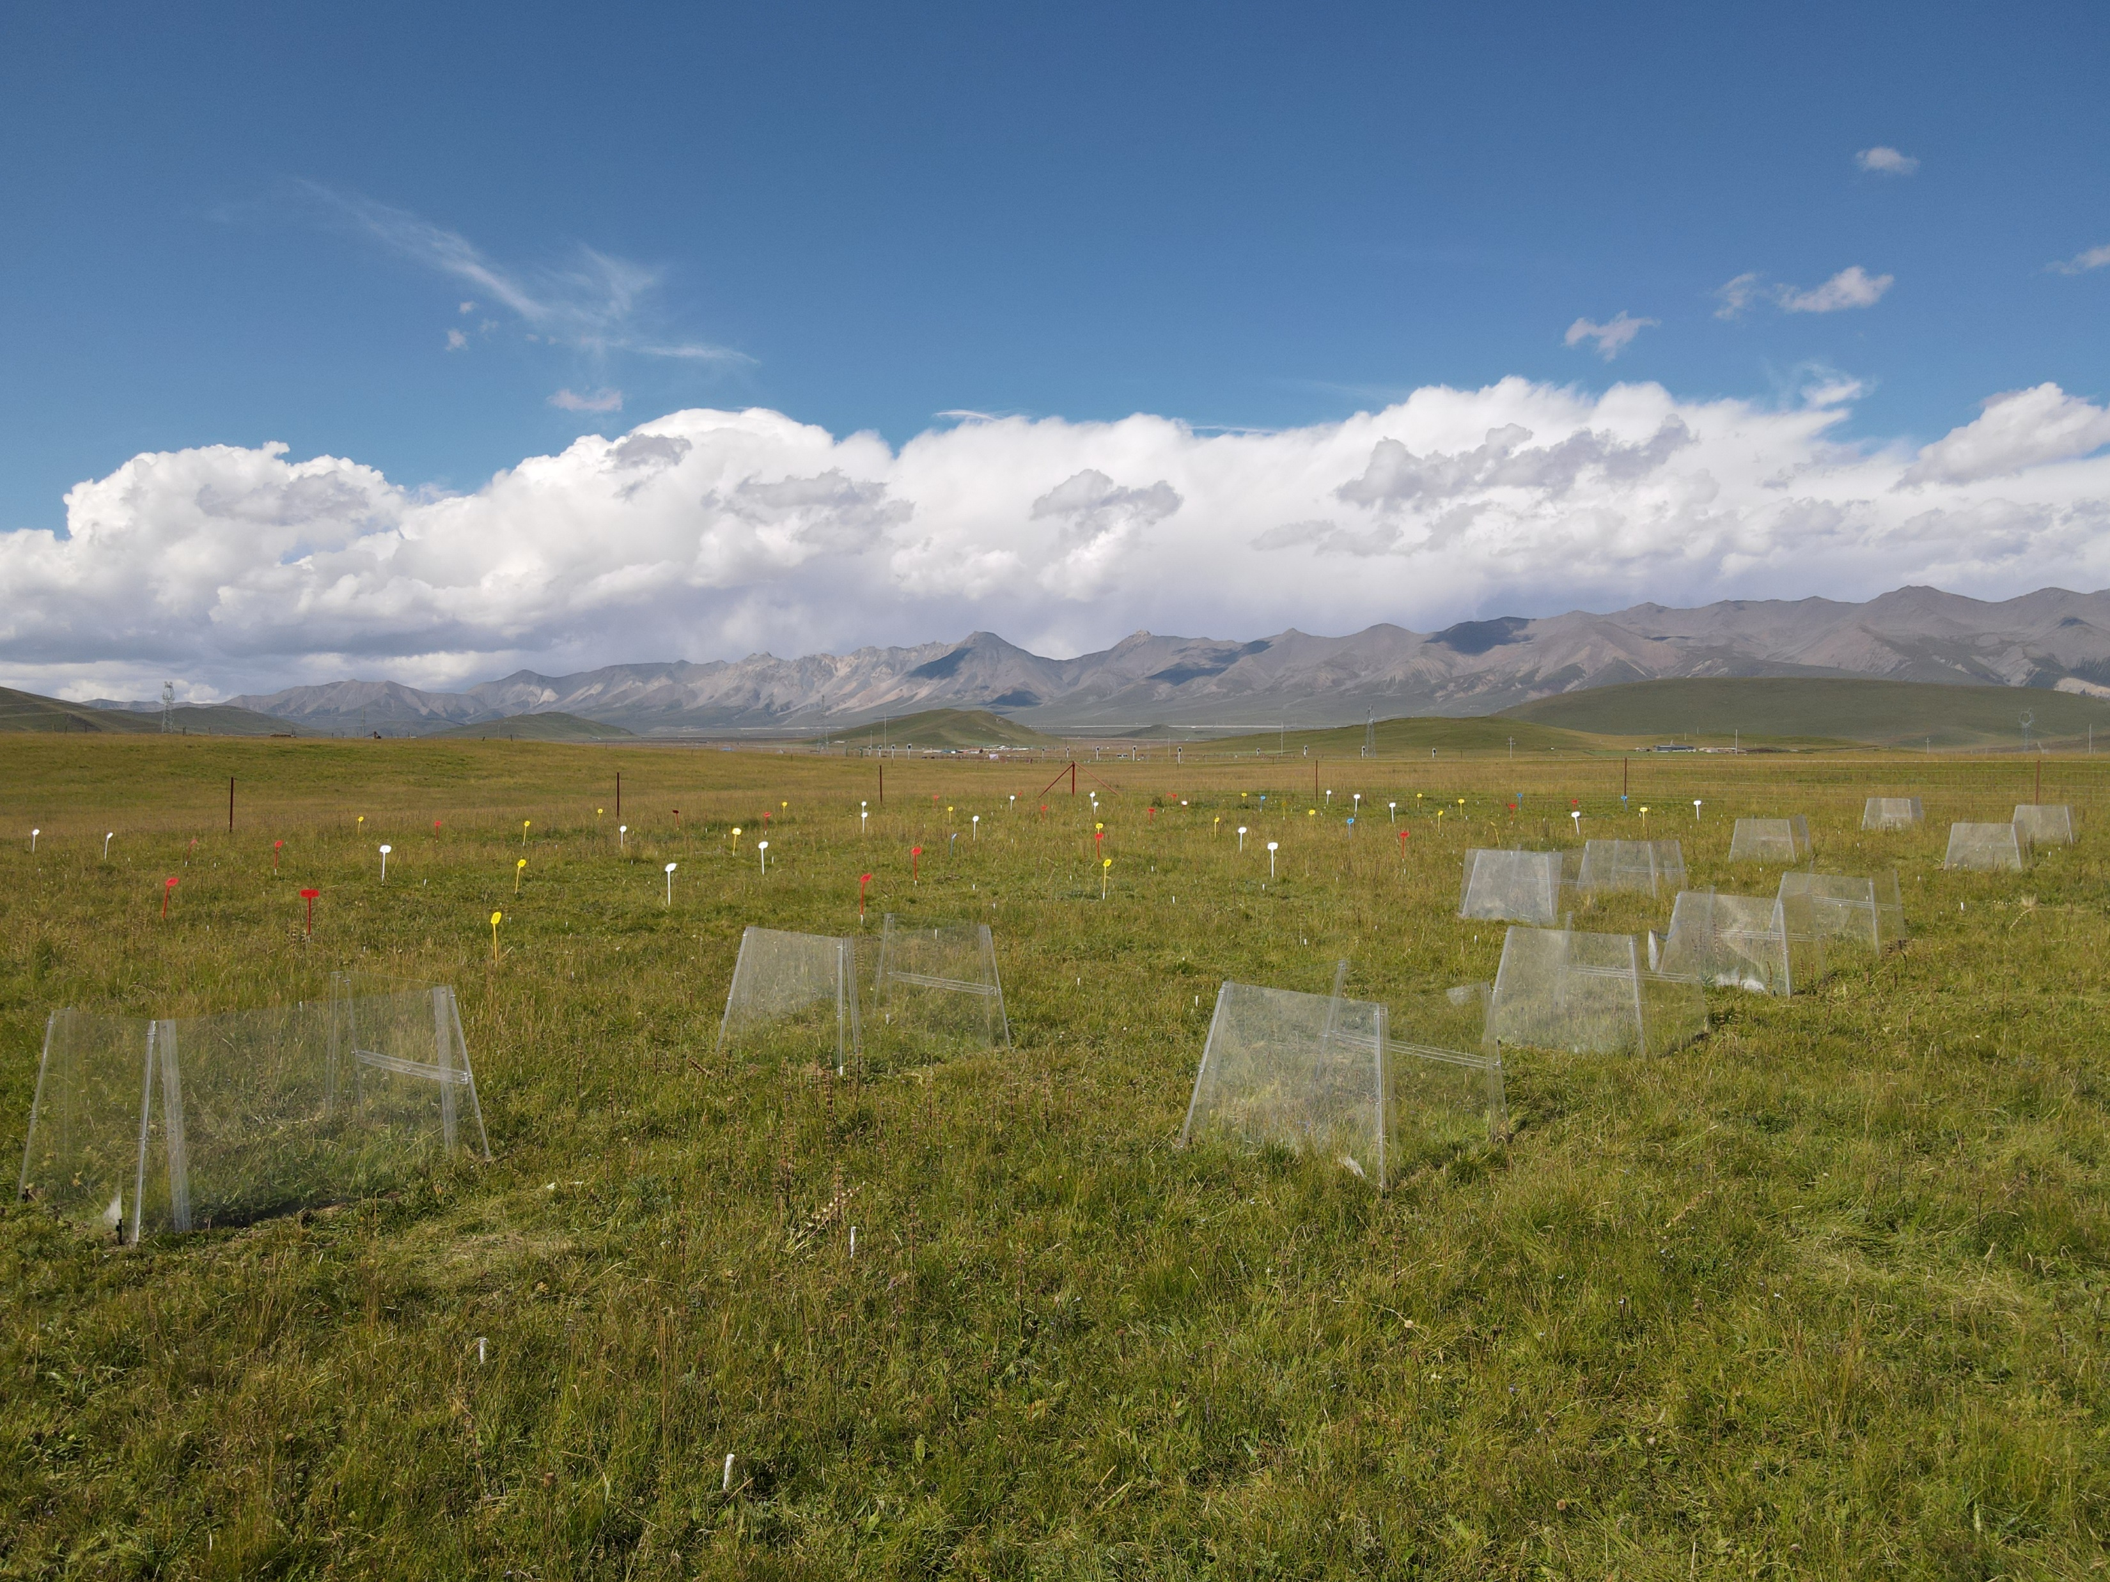
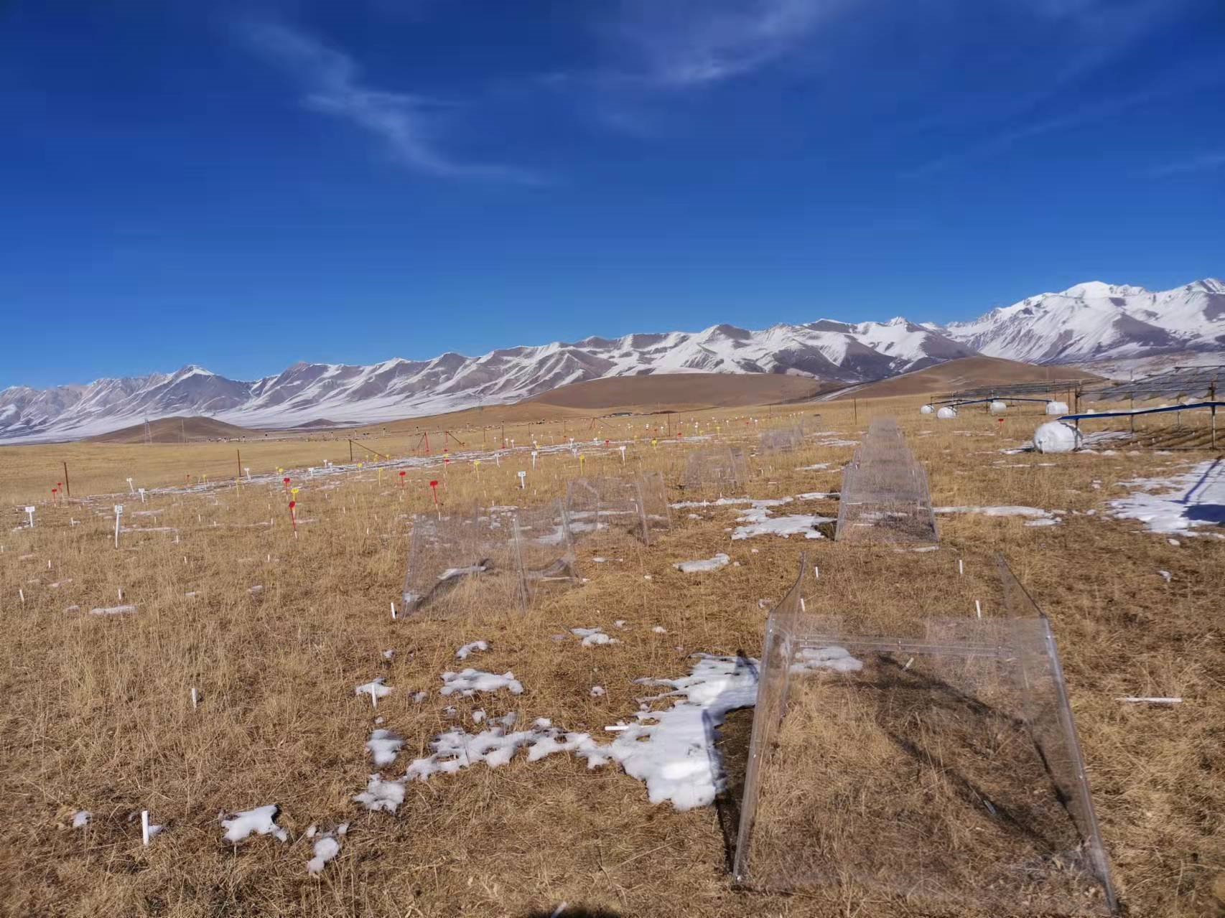
Seasonal warming on Tibetan Plateau (4750m a.b.s)
Summer warming
Winter warming
Year warming
Seasonal warming on Tibetan Plateau (3200m a.b.s)
Year warming
Summer warming
Winter warming

